Slide 1
AUDIENCES & CONSUMPTION
an industry perspective
Ally Castle
Ideally Consulting Ltd
ideally consulting ltd
strategy for creativity

Slide 2
audience research in a real-world context
Today we’ll be exploring

Slide 3
What is creative strategy?

Slide 4
I help people to have & recognise the right ideas
for them…
…by providing structure for their creativity to flourish within
Notes:
If you can’t explain it to a ten year old, you can’t explain it to yourself
help people have and recognise the right ideas for them.
You’ve probably heard : no such thing as a bad idea
But I believe : there is such a thing as the wrong idea, esp in business
For content (TV & digital), communications (marketing or advertising campaigns or ongoing communications) and corporate strategy (innovation for products and services, brand strategy or organisational structure)
For purposes of today, we’ll focus on content and broadcasting
HOW?
Walled garden.
TS Elliot said “When forced to work within a strict framework, the imagination is taxed to its utmost and will produce its richest ideas. Given total freedom, the work is likely to sprawl.”
Like an architect
It’s about setting the parameters and creating a blueprint, so there’s a plan
Or a greenhouse, about creating the right conditions for creative magic to happen

Slide 5
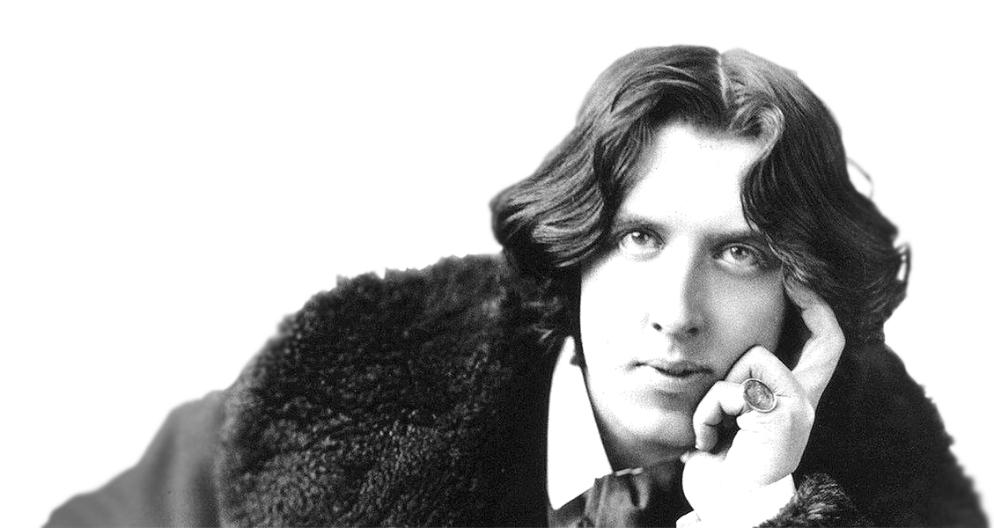
Why be strategic about creativity?
“
“
I have nothing to declare except my genius.
Notes:
One of the first thing I have to overcome when I’m talking to potential new clients is explaining why they might need me in the first place
Envy accountants, florists and wedding planners – customers know what they’re getting and know they want/need you
I have to really explain the value that I can offer – what is creative strategy, and why it will help them.
Especially because many are fairly “confident” about their creativity, like Oscar Wilde
On January 3, 1882, he disembarked from the ship that brought him from England to New York for a speaking tour, and went to the New York Customs House, where government agents asked their standard question: Do you have anything to declare? This was his response
No evidence for it - “the famous Oscar Wilde quip that he probably didn’t say…” – but makes a good point

Slide 6
How to get a TV show on air
inspiration
experience
contacts
strategy
Having and recognising the right ideas is a process of trial and error.
A strategy can give you focus and help you take out some of the risk.
Notes:
In my experience, there’s historically three reasons why a TV show gets commissioned and gets to audiences (plus many more which have nothing to do with whether they’re a good idea or not – GAG)
These three are fairly serendipitous.
The first one about coming up with ideas and making decisions from your gut
The other two are closely inter-connected and are usually about taking opportunities based on your little black book/contacts list
But I add a fourth reason for a TV show can get made – that’s robust thinking, in the form of a strategy
To use their head in the creative process, as well as their heart and their guts – and their little black books

Slide 7
How does strategy help?
A strategy =
a deliberate, consistent, rational intention
Strategic thinking is about….
bringing wisdom out of information
bringing order out of chaos
bringing decisions out of possibilities
Strategy doesn’t limit creativity, it liberates it. But how?

Slide 8
Creative strategy is like a greenhouse
It provides a structure inside which the right conditions can be created for the magic of creativity to happen.
It shelters, supports and cultivates ideas at various periods in their lifecycle, particularly when they are vulnerable to external factors.
Notes:
Where instinct, relationships and experience tend to be the most dominant factors on which creative success rests, creative strategy provides a fourth dimension.
This is particularly useful where creativity is a commercial venture, because it makes businesses more robust and gives creative endeavours another route to getting a positive reception.

Slide 9
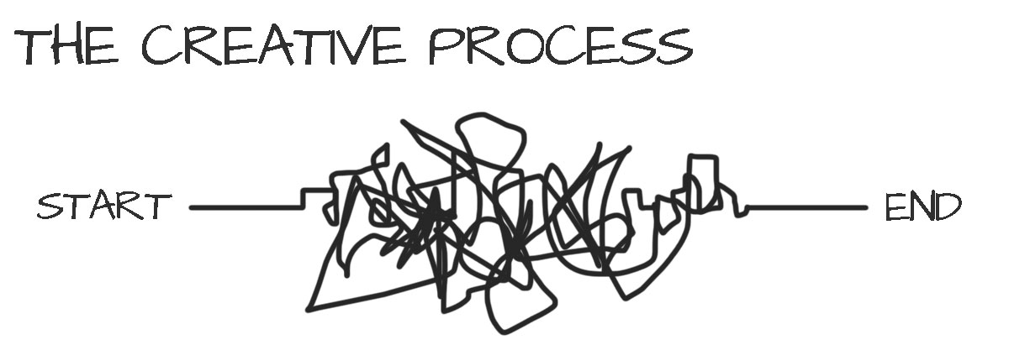
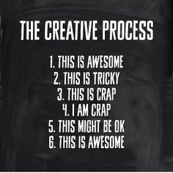
Creative strategy is about setting a direction of travel
Notes:
I talked about providing structure for creativity
Another analogy, it’s about setting a direction of travel for creativity, rather than letting it wander aimlessly (and potentially in completely the wrong direction)
Having idea is tough, you can wonder where you’re going – esp when there’s pressure to “have an idea”
Can go round in circles, get tied up in knots
There’s no certainty, cos you’re dealing with something new
Creative strategy can help give ideas three vital things:
purpose : a reason for being; an answer for the ‘why?’ of an idea
direction: a pathway to follow; an answer for the ‘where?’ of an idea
focus: an identity to live up to; an answer for the ‘what?’ of an idea

Slide 10
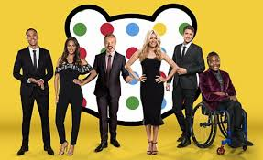
How can we attract more children to watch?
Who should we cast as the new dragon?
What personas should our gang of YouTube stars adopt?
How can the newly-formed BBC Studios work with insight to increase efficiency & competitiveness, and de-risk development?
How can we successfully take BBC Three off TV and make it online-only?
How can we raise more money during the Children In Need appeal night?
Notes:
Types of questions I’ve helped answer
All real examples

Slide 11
This often, but not always, rooted in audience research.
It’s about drawing on any tools and techniques necessary to set an informed direction of travel to get to the right solution.
Notes:
The secret of success is often in choosing those tools wisely and bring their outputs together, to join the dots/put pieces of jigsaw together and bring all the thinking together succinctly and in a way that allows you to take a bit of a leap.

Slide 12
Some tools & techniques of creative strategy
audience research
social trends
cultural insight
workshops & brainstorms
market mapping
brand thinking
content analysis
storytelling techniques
creative theory
Creative strategy is audience research in context and in action
Notes:
Techniques

Slide 13
Strategy is also a way of thinking
To bring wisdom out of information, it’s best to be good at interrogating
To bring order out of chaos, it’s best to be good at connecting
To bring decisions out of possibilities, it’s best to be good at simplifying
Be curious, always question things
Spot patterns and relationships
Get to the real heart of the matter
All qualities that good creatives need as well….
Notes:
state of mind

Slide 14
Some (unofficial) theories creative strategy relies on
Notes:
Health warning : this is based on experience and instinct, not empirical evidence
Creativity is notoriously hard to pin down. In fact its mysterious, ethereal nature is the very thing that drives it and makes it valuable. But for those of us in the business of ideas it sometimes helps to have a framework by which to try to understand creativity (even if it fully evades totally logical rationale), so that we can get the best out of it.
I’ve been in the media business my whole professional life. Now two years of running a creativity strategy consultancy, working with a clients across broadcasting, production, digital sectors and beyond has brought my understanding of the creative process into sharp relief. These are my observations, based on my professional lived experience.

Slide 15
1. Creative practice makes perfect
Notes:
EVERYONE is, or can be, creative - need to exercise your creative brain like you would a muscle – strengthen it.
My blog post: “to create is to be human”: “we only have to look at the fields of brain injury rehabilitation or mental illness therapy to see how the presence of creativity can heal. And then just look at your average play group or nursery class, and you just can't argue that creativity is an instinct within us all. It is what gives us purpose and makes us human. And we can all do it; there is no such thing as someone who is not creative.”
One thing you have to practice is the capacity to bring old elements into new combinations depends largely on the ability to see relationships
James Webb Young in his book, A Technique for Producing Ideas: “To some minds each fact is a separate bit of knowledge. To others it is a link in a chain of knowledge.”
Practice spotting patterns and connecting the dots of your observations, knowledge and experience, to create new combinations – luckily as researchers, this is what you do. But apply to things beyond analysis, to every part of the process
Creativity is rarely a Eureka moment: Steven Johnson in Where Good Ideas Come From, talks about the slow hunch rather than the moment of creative insipiration

Slide 16
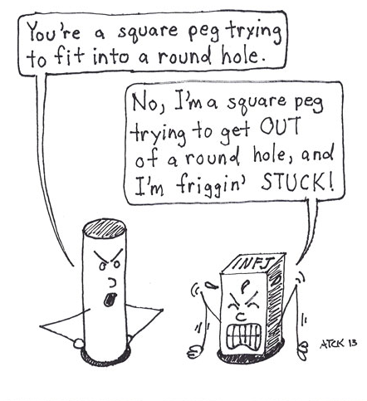
2. There is such a thing as a wrong idea
Notes:
You need ideas which are right for the challenges you have; they need to be a fit for the problem
Don’t get stuck in ruts. don’t stop questioning things – need to be self-aware, be reflexive, allow in some objectivity, be honest with yourself

Slide 17
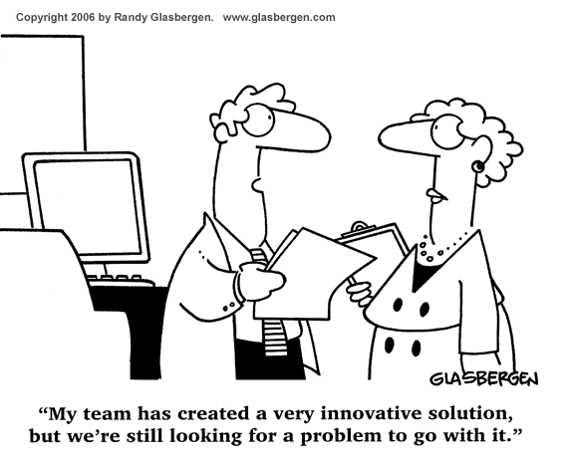
3. Creativity isn’t always radical innovation
Notes:
there are different layers of creativity - from not derivation, to evolution, to revolution, to innovation.
Sometimes it just needs a slight turn of the wheel
No point in innovation for innovation’s sake; has to be for a purpose
And we don’t have to start from scratch
CF : everything is a remix - Nothing is original; from Bob Dylan to Steve Jobs, he says our most celebrated creators borrow, steal and transform.

Slide 18
4. Creativity is a two-sided exchange
idea creator
idea receiver
Notes:
Every idea needs an audience
That’s why some people can’t see that their ideas are bad – they’re not thinking of the people on the receiving end
It’s a transaction
It’s only meaningful or valuable if it’s well received, if it has an audience that appreciates
Occasionally, that audience might be you as well – a gift to yourself
But usually its you’re customers or clients or employees – and your bank manager
Don’t have ideas because it would be fun to do – do it because there is a need for it or a benefit to it
Know who your ideas is for – and be as specific as possible

Slide 19
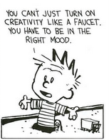
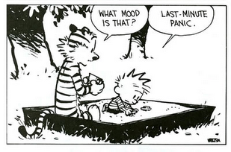
5. Creativity can’t be forced
Notes:
Despite what I said about practice makes perfect….
nature vs greenhouse. – it does need the right conditions, to naturally flow
“Planning = preparedness for creative accidents to happen”- Henry Mintzberg, a professor of management at McGill University
Also calls the phrase "strategic planning" an oxymoron. He argues that real strategies are rarely made in paneled conference rooms but are more likely to be cooked up informally and often in real time—in hallway conversations, casual working groups, or quiet moments of reflection on long airplane flights.
or creating an environment “where ideas can have sex” (cf the concept that nothing is new, it’s just a remix of existing ideas) TED talk – where good ideas come from : the English coffee house was crucial to the birth, development & spread of the Enlightenment. Previously, people drank alcohol throughout the day time (water wasn’t safe). So, everyone’s drunk all day. Then switched from a depressant to a stimulant to drink. But was also important cos the architecture of the space – his whole talk (and work) is about studying the environments which lead to unusual levels of innovation and creativity.

Slide 20
Analogies for creativity
a cup of tea
a team sport
a journey
an unruly toddler
a tightrope walk
Notes:
I think there are 5 useful analogies we can apply to creativity which might help us get some kind of handle on it and encourage ourselves that we’re getting it as right as we possibly can. Of course, these are just my observations and not based on empirical evidence, but lived experience.

Slide 21
Thank you
ally@ideallyconsulting.com
@Ally_Ideally
#creativebest

